Slide 1
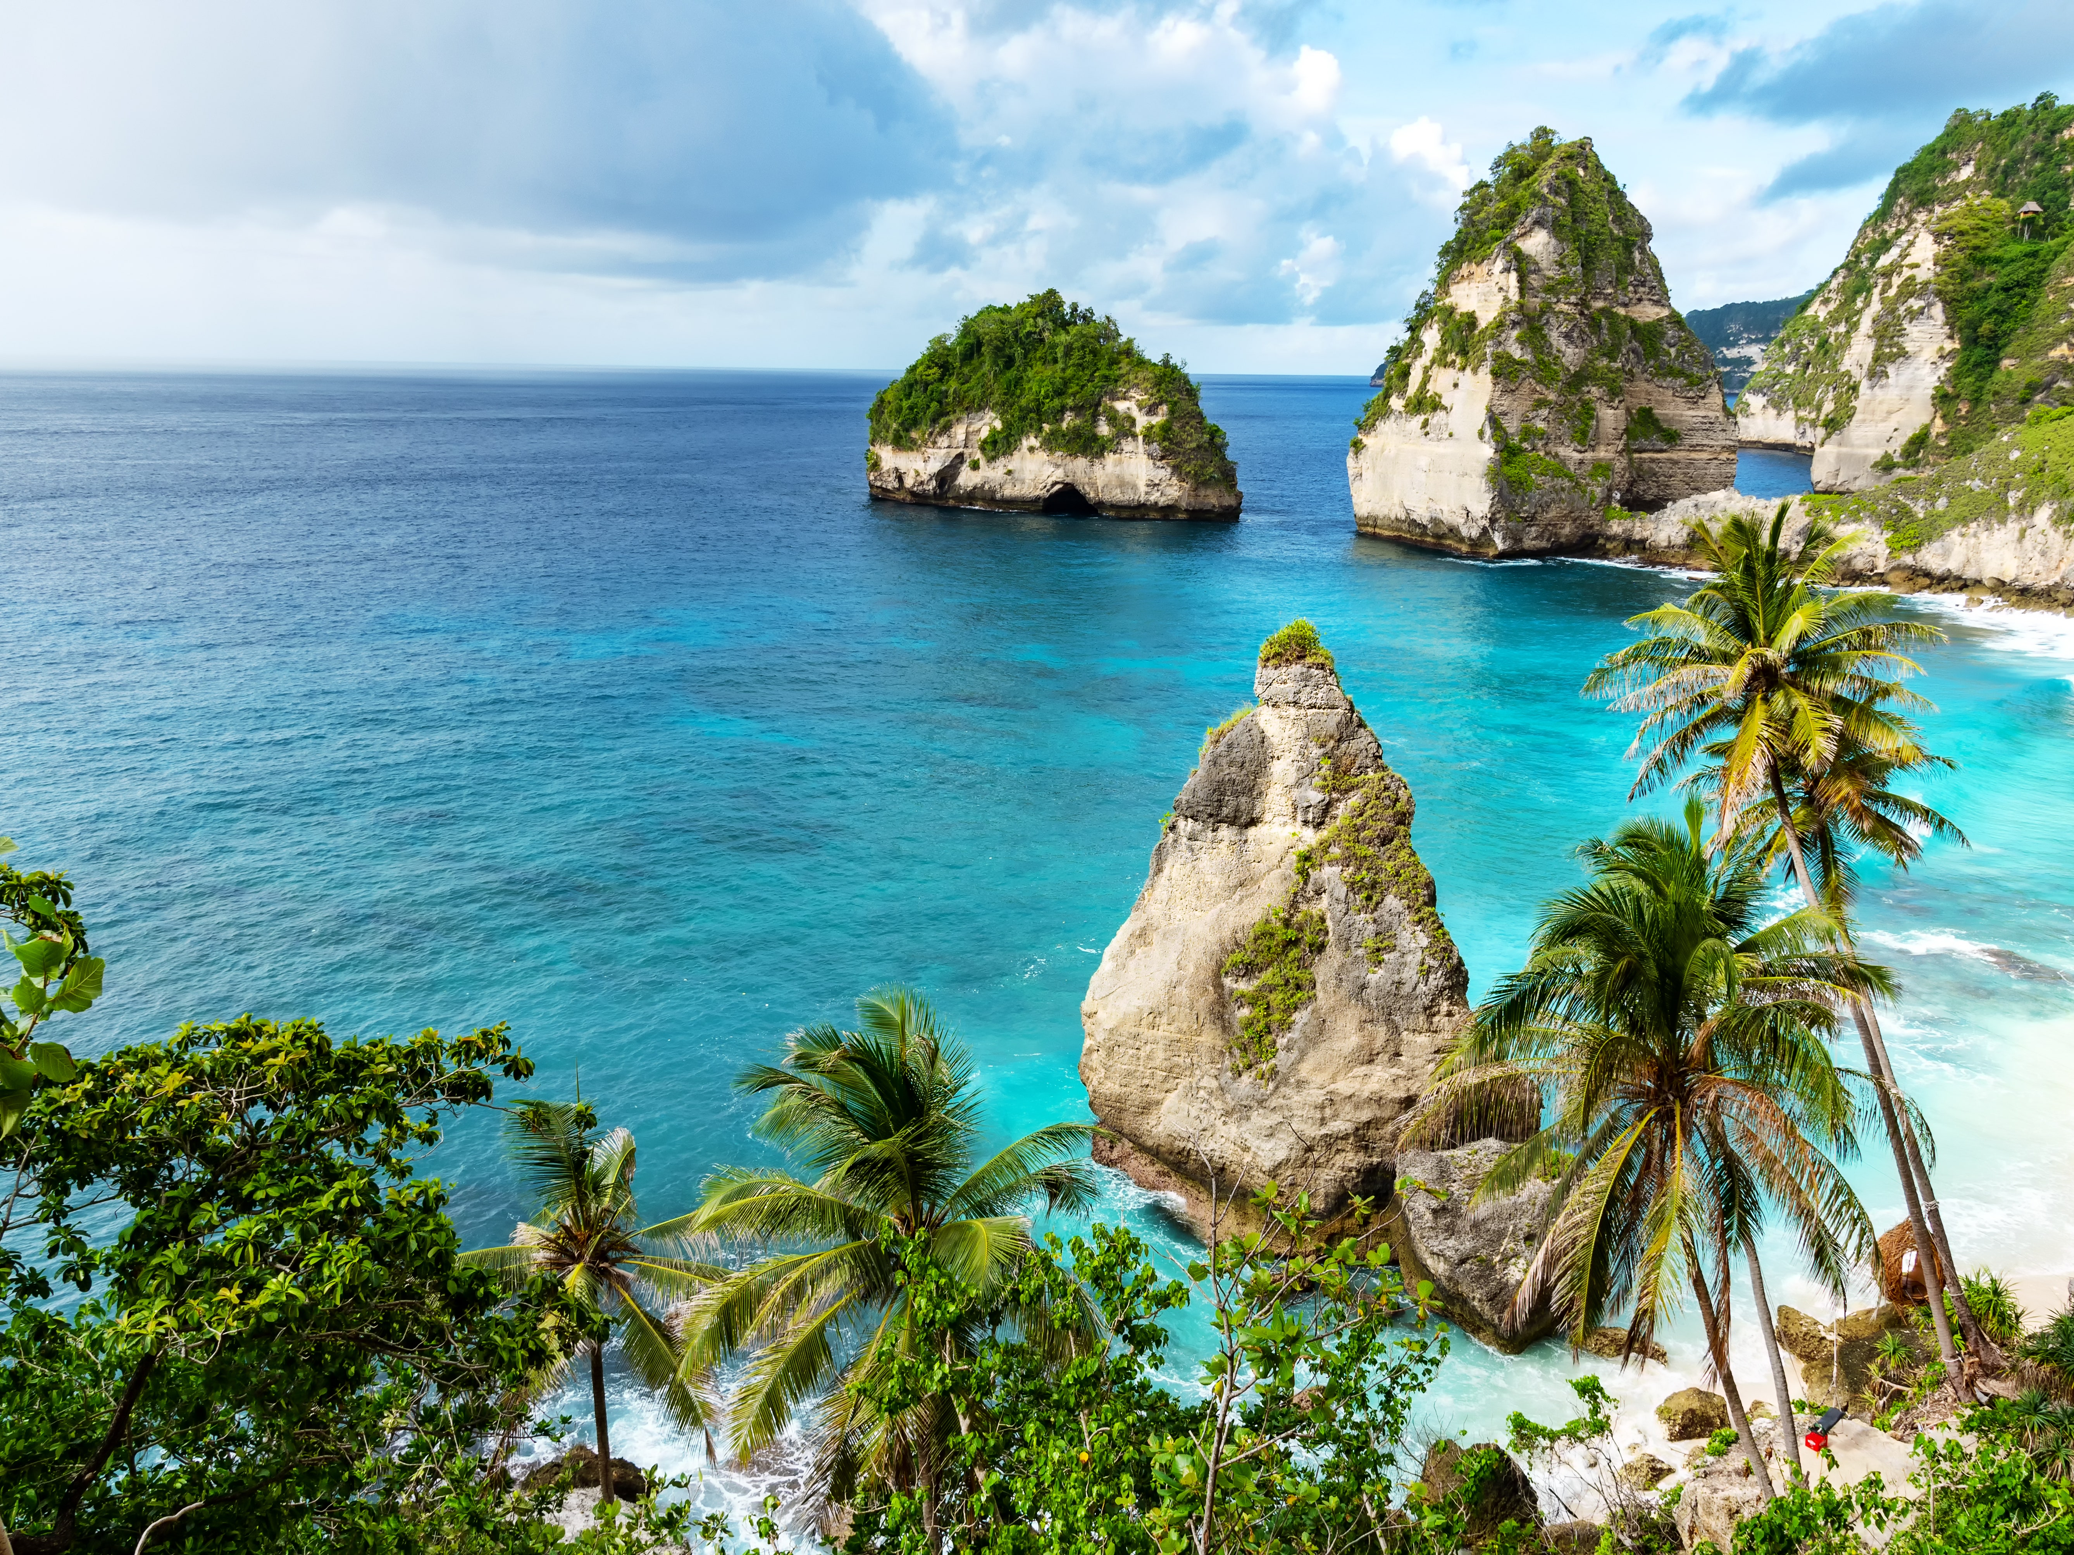
Bali
By Halla elsharkawy

Slide 2
Outline:
Location, population, currency & cultural value of Bali (Introduction)
Purpose of visiting
Attractions
Conclusion

Slide 3
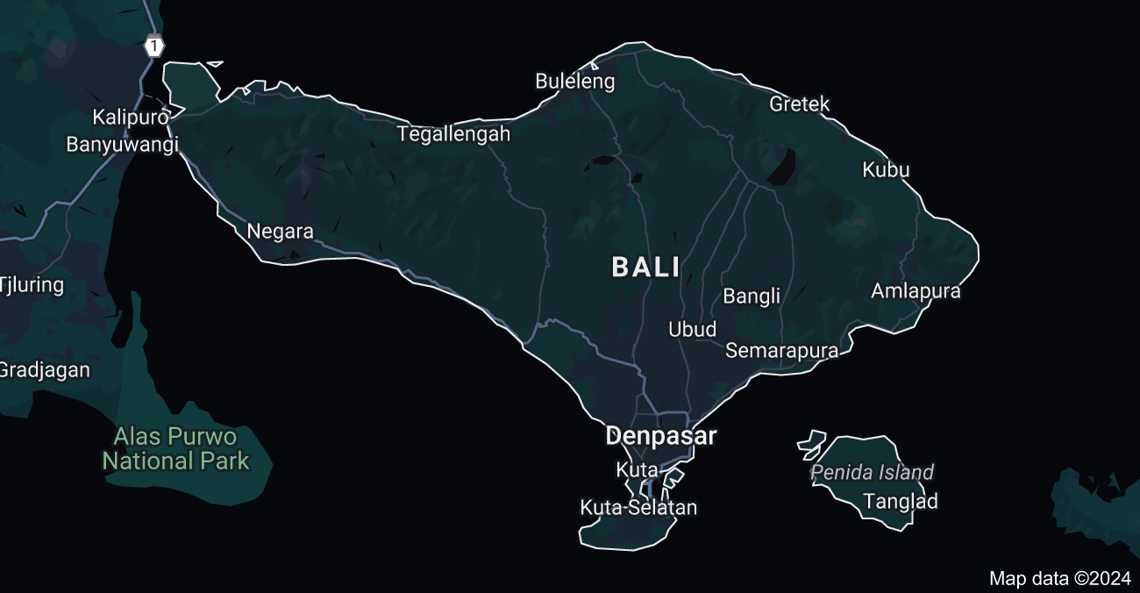
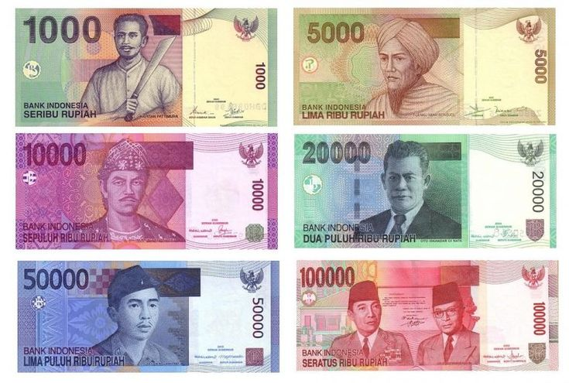
1: Introduction
Location: lesser Sunda island, Indonesia
population: 724,588
Currency: Indonesian Rupiah (IDR)
Cultural value :
Blend of Balinese Hinduism , traditional arts , music, dance and vibrant ceremonies
Emphasizes community , harmony and spiritual connection
Traditional dances play a crucial role in preserving and passing down cultural heritage

Slide 4
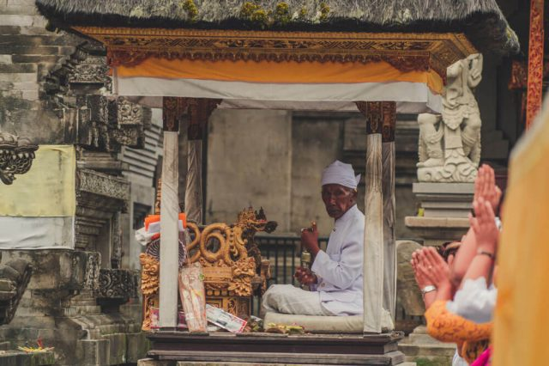
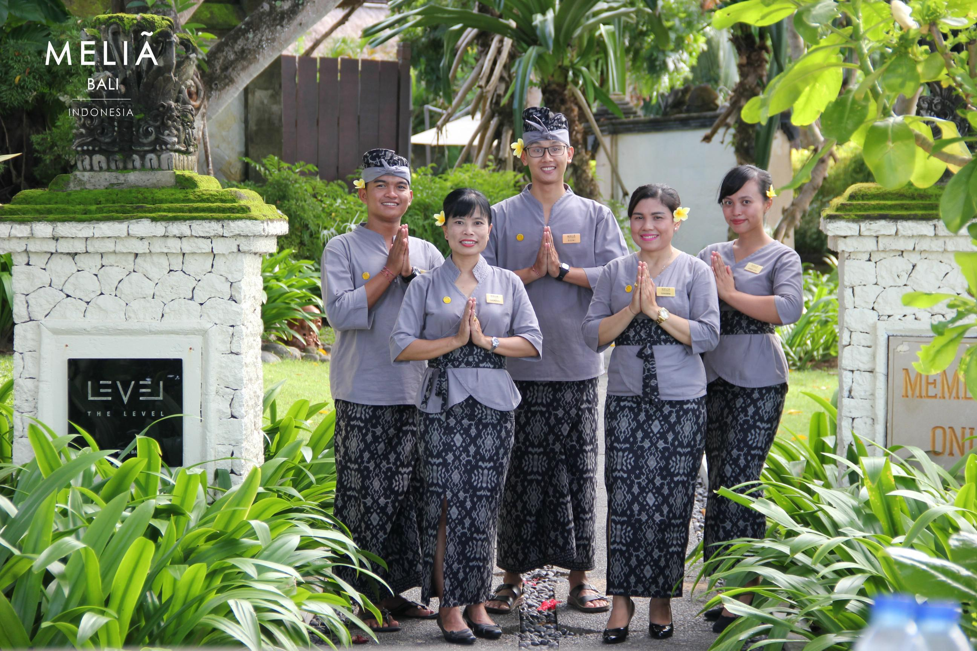
2: Purpose of visiting
Stunning beaches
Lush landscapes
Vibrant cultural scenes & spiritual experiences
Offering diverse range of activities such as ancient temples & traditional markets
It’s warm hospitality
The blend of tradition with modern amenities

Slide 5
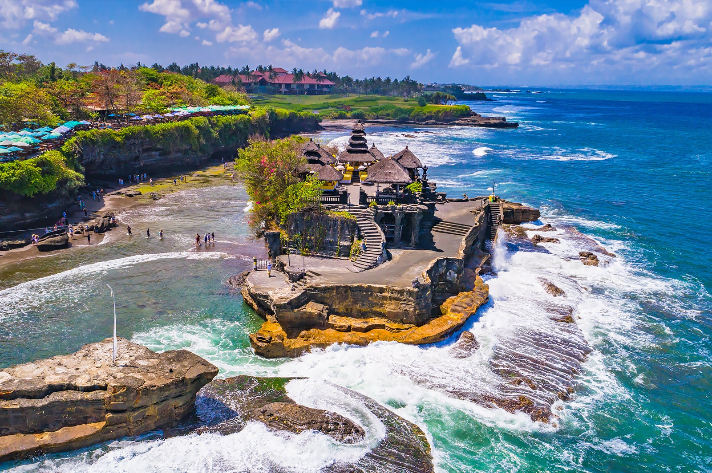
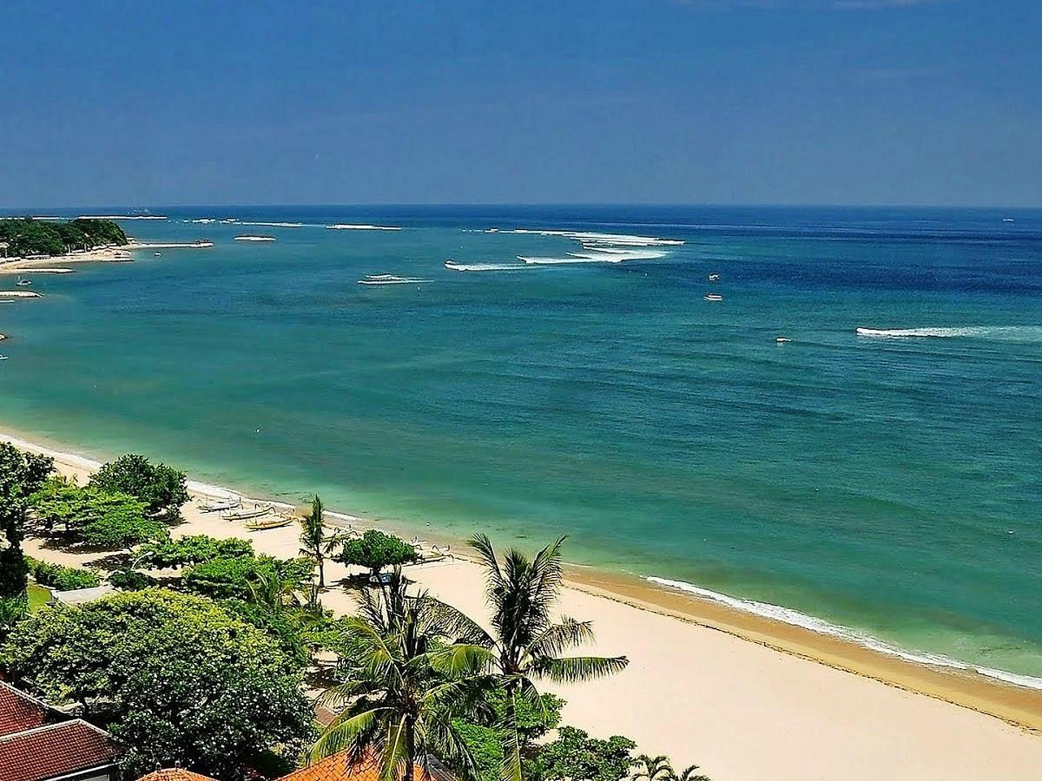
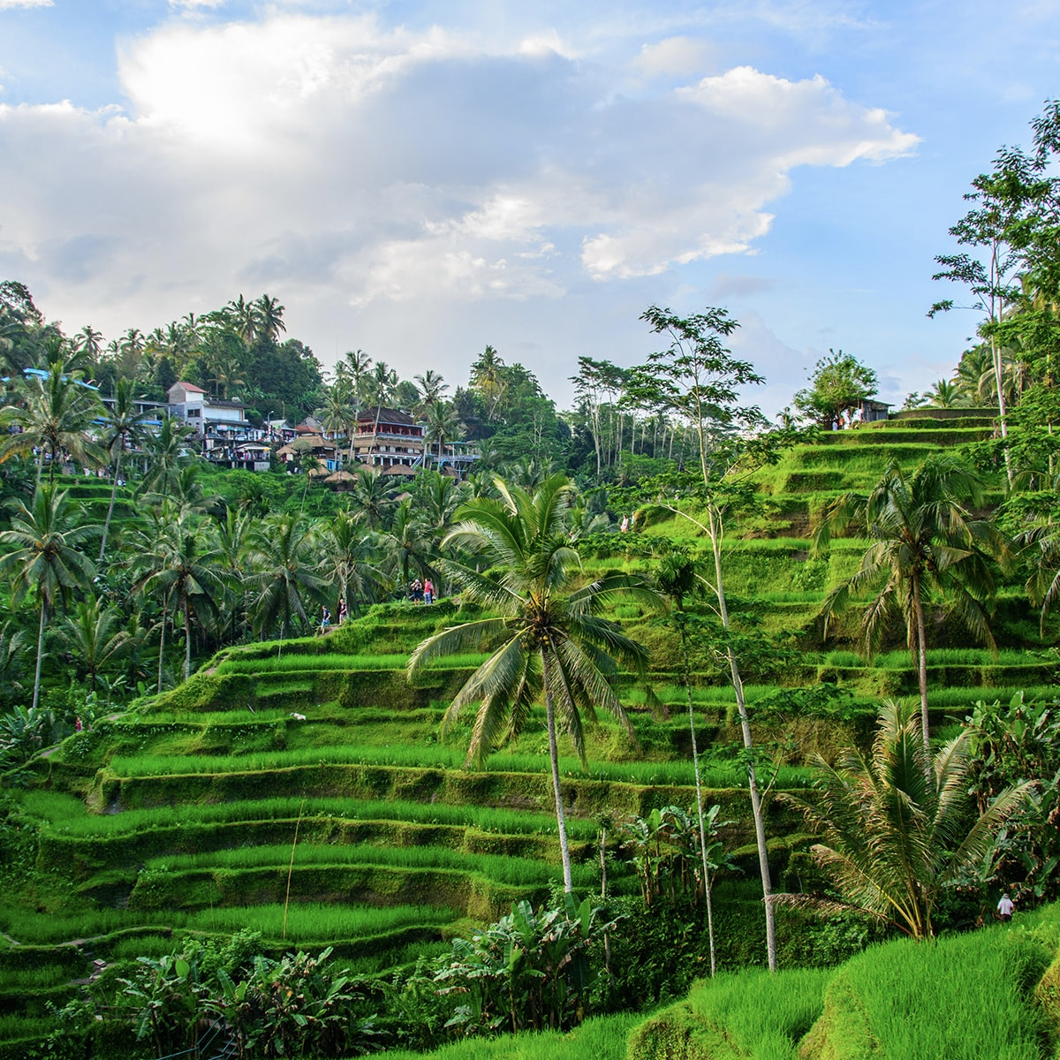
3:attraction
Tanah lot temple
Kuta beach
Tegallalang rice terraces

Slide 6
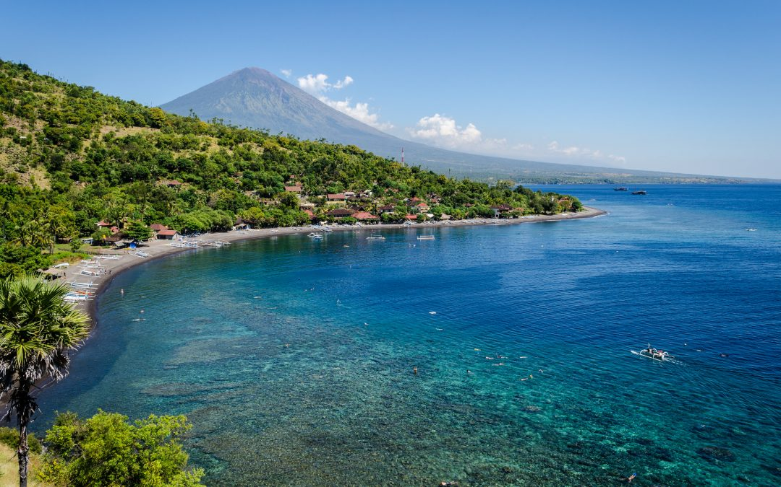
Dry season 19/5/2025
A month
Friends

Slide 7
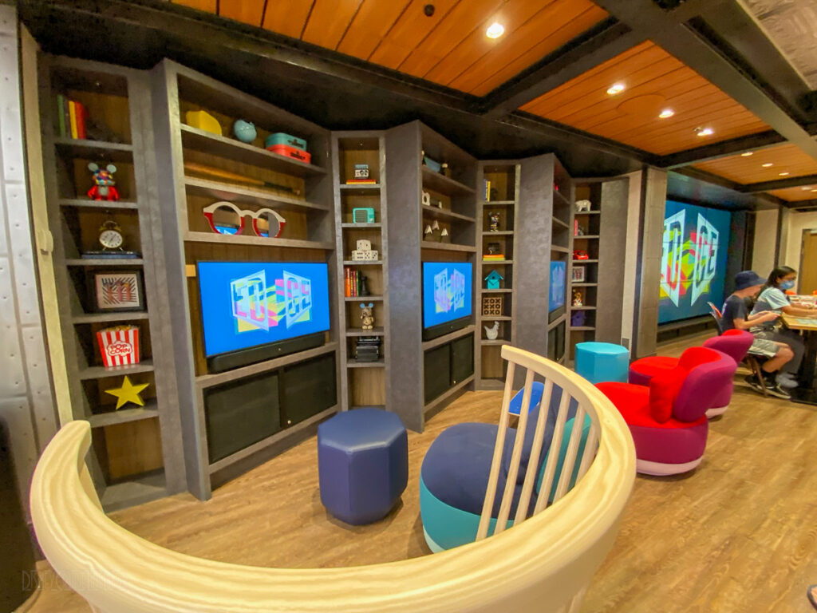
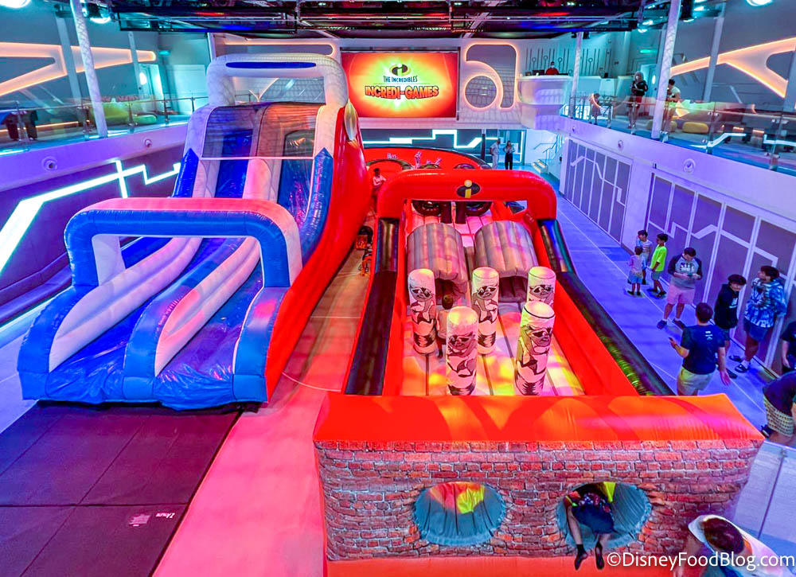
Edge walkthrough
Hero zone

Slide 8
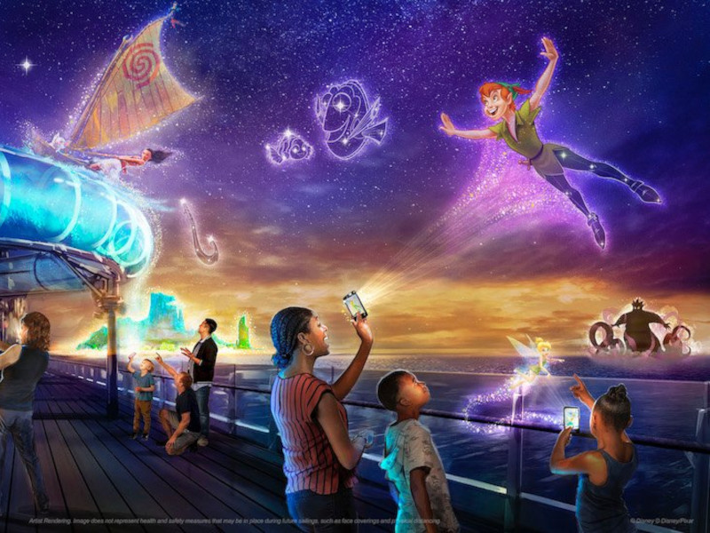
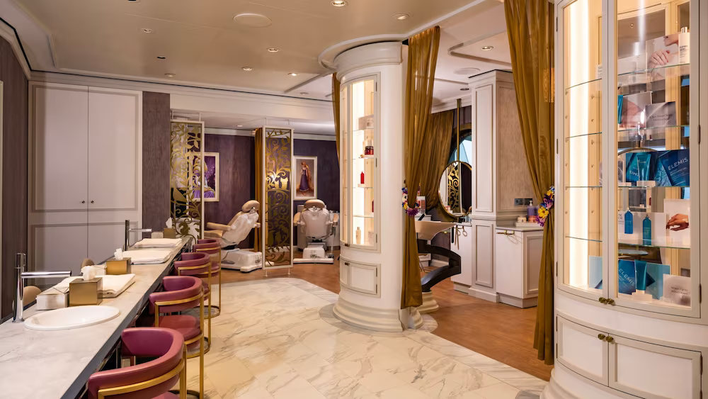
Night clubs
Untangled salons
Disney uncharted adventure

Slide 9
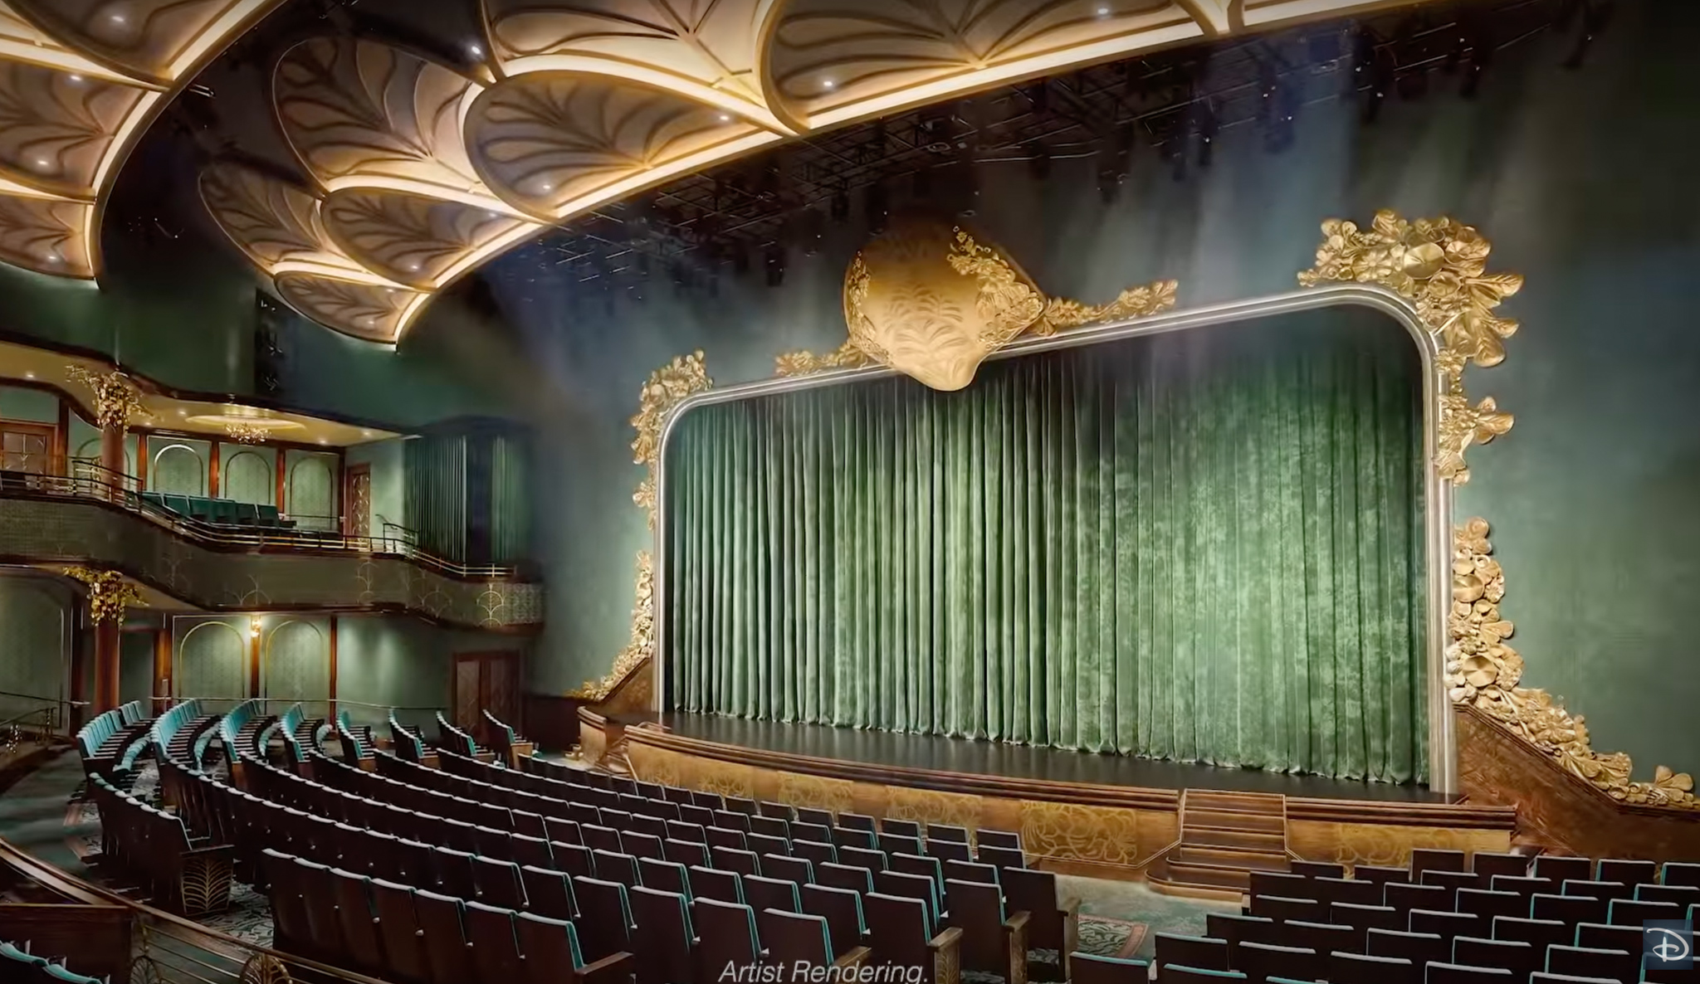
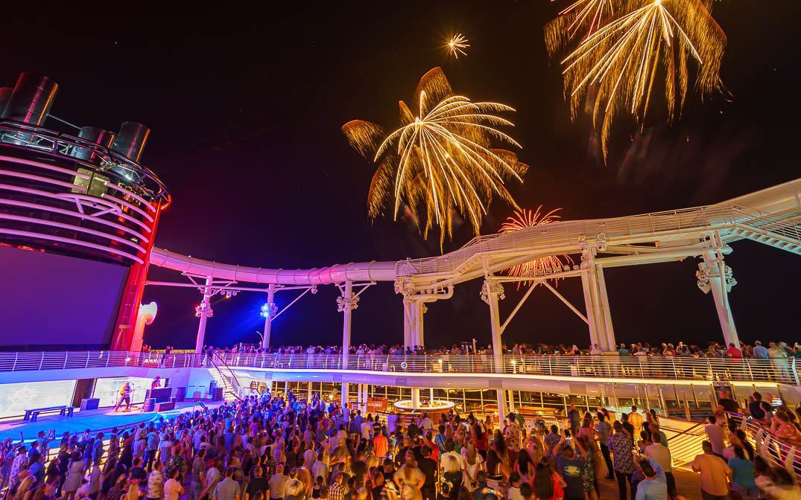
4.Different means of entertainment
Walt Disney theater
Fireworks at the sea

Slide 10
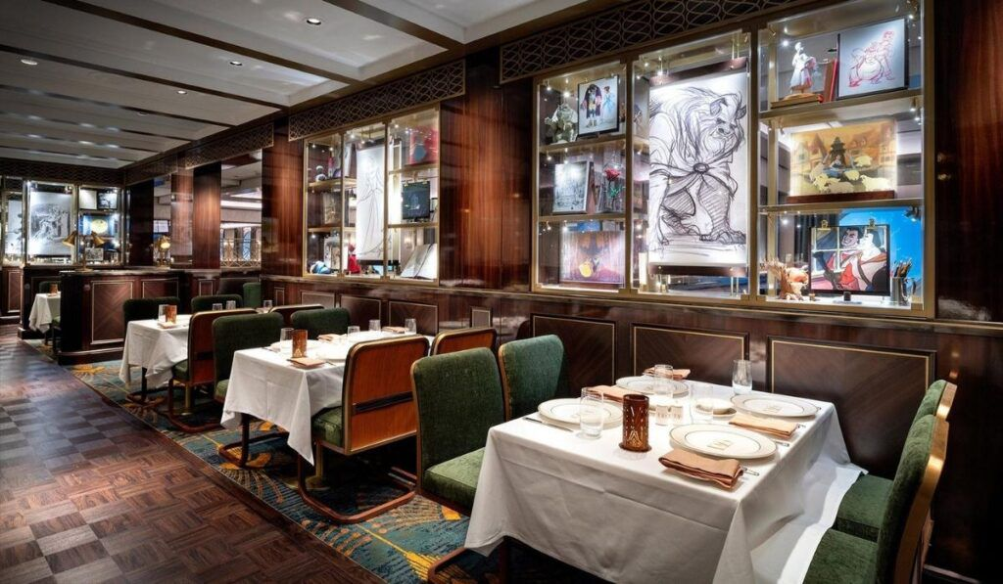
5:Different places offering food and beverage
1923 resturant
The frozen dining adventure

Slide 11
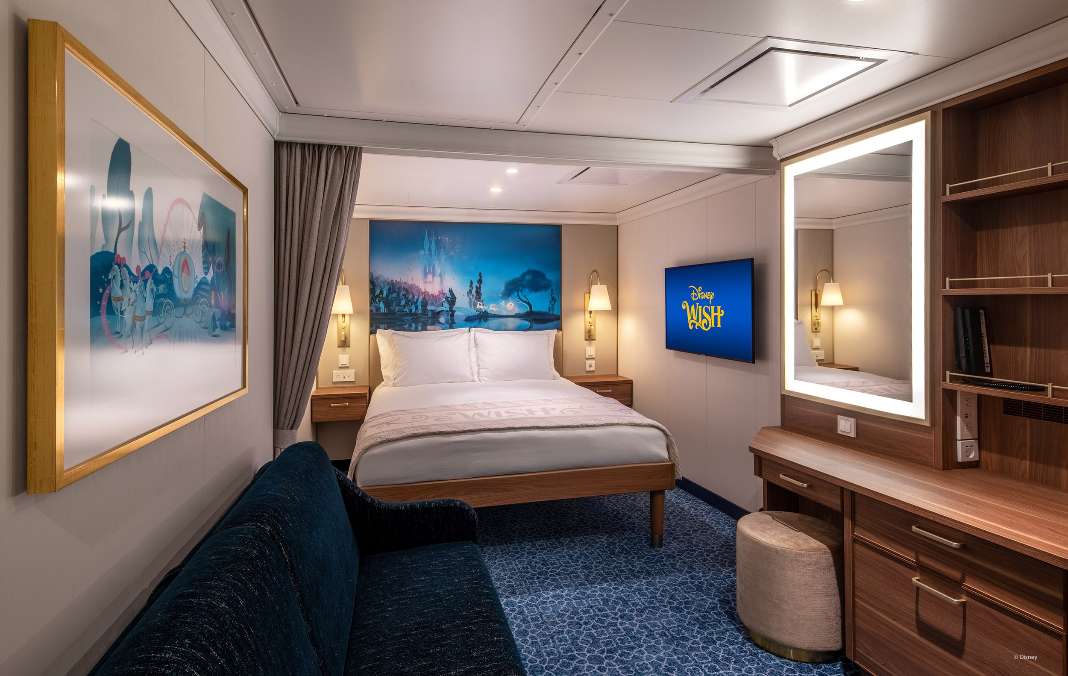
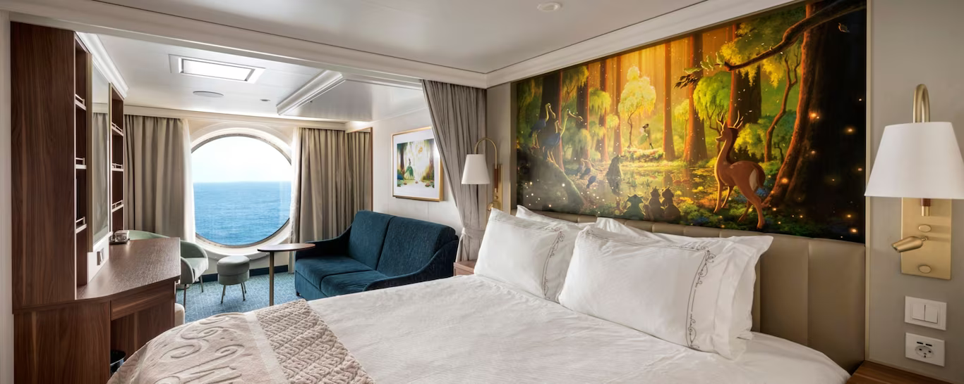
6:Details of accommodation
Inside staterooms
Deluxe Oceanview stateroom

Slide 12
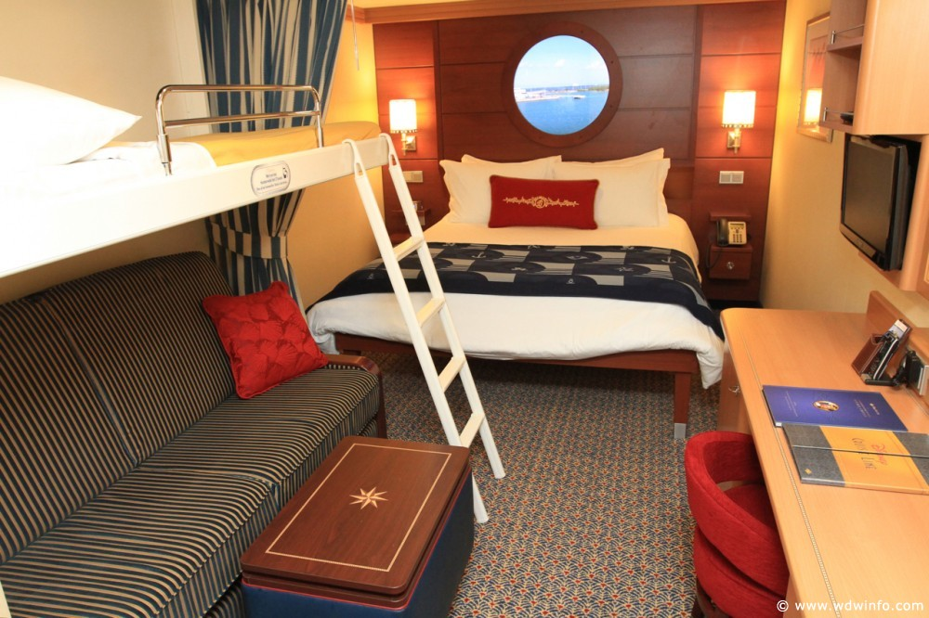
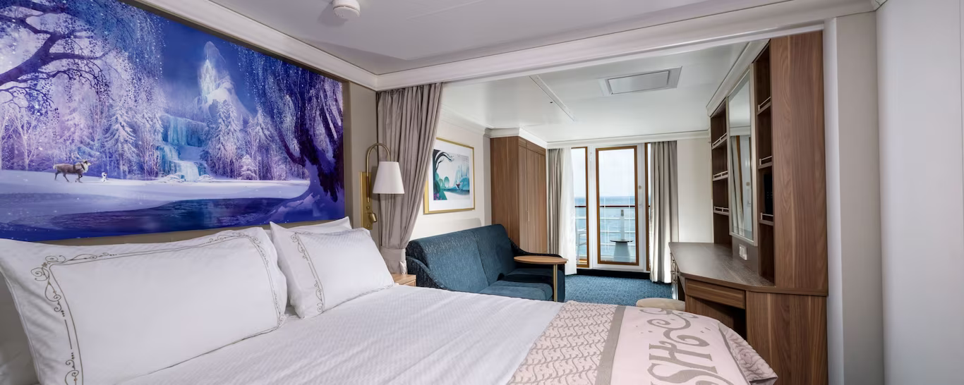
Deluxe Oceanview with verandah
Deluxe family Oceanview with verandah
Deluxe family Oceanview

Slide 13
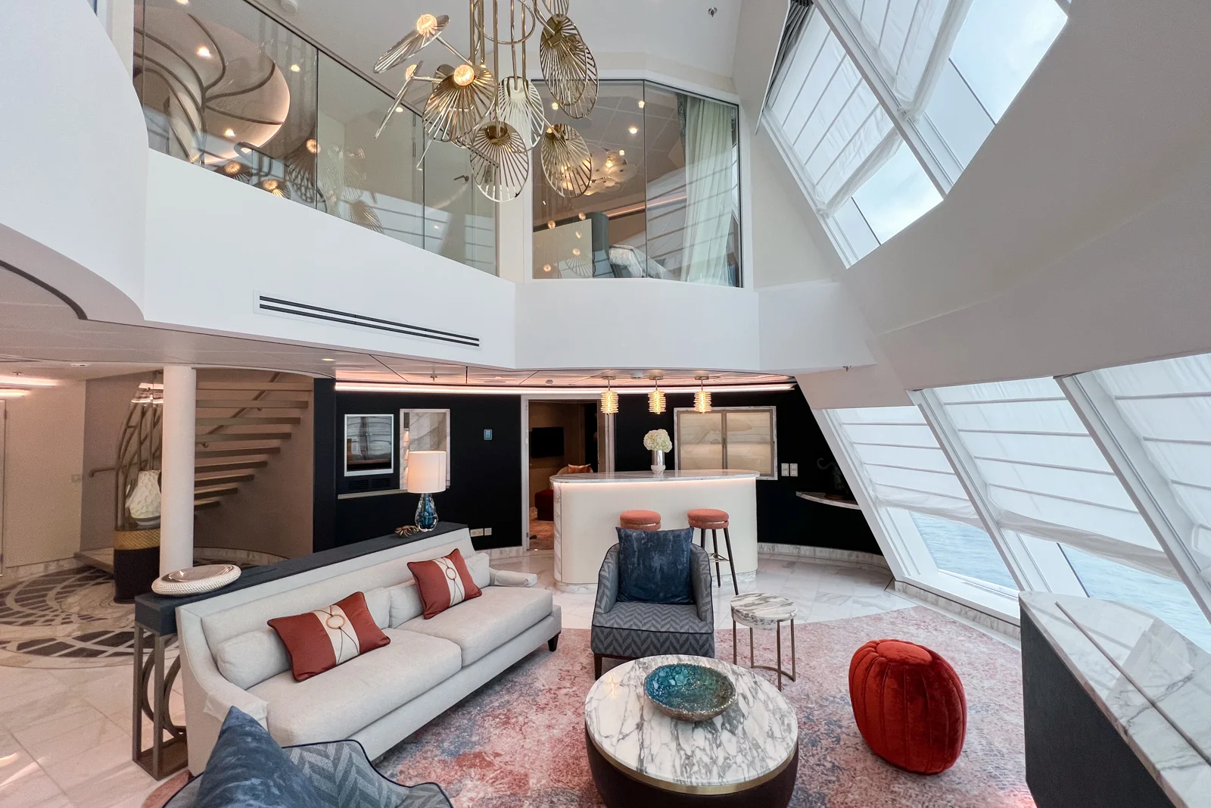
Suits

Slide 14
8:Conclusion
I see in my own point of view
The wish Disney cruise is the best vacation family can take
It has so many activities and entertainments
People will not stop having fun and playing with Disney characters
Children will never get board
The ship is themed in a magnificent design and breathtaking views

Slide 15
Thank u

